Slide 1


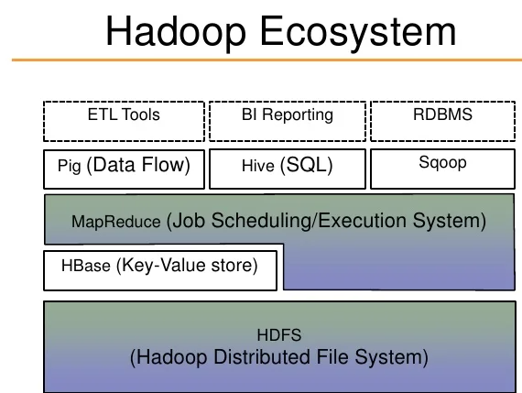


Data Flow Architecture of Auctions
Superset Analytics
Data file
Data ingestion
Data Storage
Data Processing
Apache nifi
Apache nifi
Email for alerts of Auctions

